Slide 1
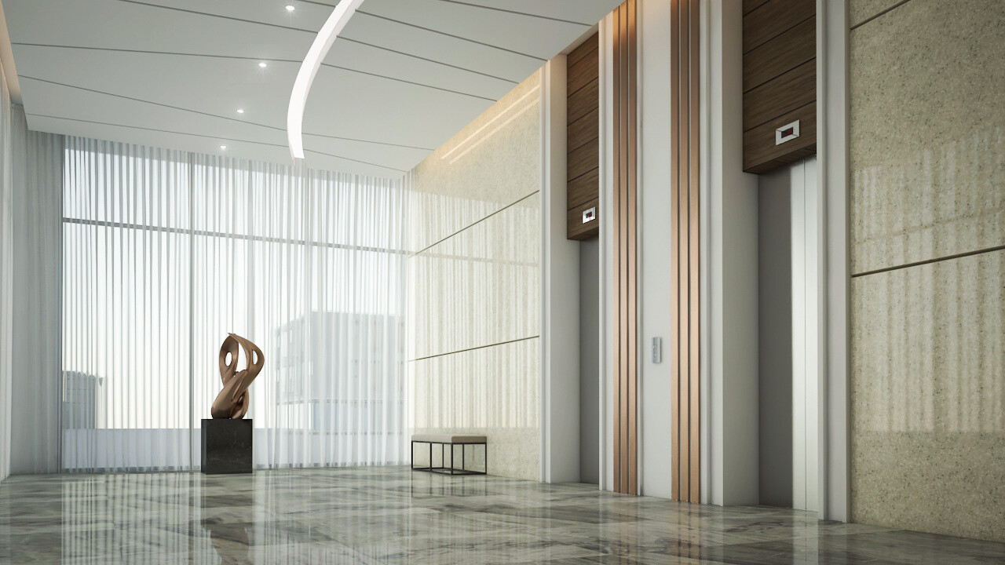

Pitch EMPRESA DE ELEVADORES
ALGORITMOS E ESTRUTURAS DE DADOS
Beatriz Aguiar up201906230
Margarida Vieira up201907907
Matilde Oliveira up201906954

Slide 2
PITCH
Description
Pitch is a company that manages, not only a set of lifts, but also their owners, Pitch's Clients. These lasts, can be of type Entrepreneur or Particular Client. The company works with a vast number of Employees, more specifically Service Providers, and Contracted Employees. The Service Providers are responsible for the exceptional execution of the maintenance. The need for maintenance is automatically controlled by the system, based on specific functioning control parameters. However, if and when desired, the owner is free to request a maintenance execution for his lifts. In both cases, the maintenance will be executed by one of the Service Providers, chose randomly. The Contracted Employees plays the role of lift manager. Once an Entrepreneur enters the Pitch data base, a Contracted Employee, that by default is the one with currently less Entrepreneurs associated, and who he can review anytime he wants, is associated to him. Pitch keeps track of all the lifts that have ever entered the data base which means that, once a Client is removed from it, the lifts he owned are automatically transfered to the company's name. Additionally, if the one removed is an Entrepreneur, his association with the Contracted Employee will is canceled. Also, if an Employee is selected to be removed, one of two scenarios can happen. If the Employee is a Service Provider, he will be immediately removed from the data base. But if the Employee is a Contracted Employee, his associated Entrepreneur, if so exists, will be associated to another Contracted Employee whose selection, once again, will respect the criteria mentioned above.
AEDA Grupo 2 Turma 4

Slide 3
Implementation
PITCH
Pitch
This is where all data is stored.
Vector<Client*> clientes;
Vector<Employee*> employees;
Vector<Lift*> lifts;
Vector<Lift*> ownedLifts;
Utils.h
This header file is used for the implementation of helpful utilities and algorithms.
class Date
class Time
Binary Search
Sequential Search
UserInterface
This class is where all the magic happens. As the name suggests, this class implements the connection between the user and the Pitch Company.
Office
The user can access the Pitch Company Office & insert, remove or analyse the company’s data.
Building
The user can choose a lift to “travel” in. We tried to make it as realistic as possible.
Exception
Exception classes will be thoroughly explained later.
ClientDoesNotExist
EmployeeDoesNotExist
LiftDoesNotExist
NotAnEntrepreneur
InvalidDate
InvalidTime
InvalidNumFloors
AEDA Grupo 2 Turma 4

Slide 4
Implementation
PITCH
Lift
Each lift is identified by its code, static parameter.
It has a few other identifiers, such as its adress & client’s nif.
Important parameters:
static doorOpens
vector<Moves>movesHistory;
vector<Maintenance> maintHistory;
int regularTime;
struct Maintenance{
Date date;
unsigned int nifEmployee;
};
struct Moves{
Date date;
int from;
int to;
int floorCount;
Time tInitial;
Time tFinal;
};
Employee
All employees have an evaluation (1-5) & an identifier (nif).
According to its salary, na employee can be a Service Provider or a Contracted employee.
Service Provider’s function is the lift’s maintenance.
perHourSalary
hoursWorked
Contracted Employee’s are associated to Entrepreneurs.
perHourSalary
Vector<Client*> clientsAssociated
Client
According to its nif,,the identifier, a cliente can be an entrepreneur or a particular client.
Entrepreneurs have their own lift manager (Employee).
Both clientes store owned lifts.
vector<Lift*>lifts;
AEDA Grupo 2 Turma 4

Slide 5
Implementation
PITCH
Pitch
User Interface
Office
Buildings
Show Pitch Data
Add Clients & Employees
Remove Clients & Employees
Register Client data
Buy new lifts
Evaluate employee
Request maintenance to owned lift
Show lifts
Choose a building
Call lift
Go up/down the stairs
Call emergency
EnterBuilding()
Choose Building
Call lift
Go up/down the stairs
Call maintenance
AEDA Grupo 2 Turma 4

Slide 6
UML
PITCH
For visualization purposes, we provide a link to a folder in the up drive (must be accessed via @g.uporto.pt) that contains the UML.pdf and the videos displayed in this powerpoint.
https://drive.google.com/drive/u/1/folders/1Uv0Qr5fcY0rVxmi8KigwKw5LNI0PN7EE
AEDA Grupo 2 Turma 4

Slide 7
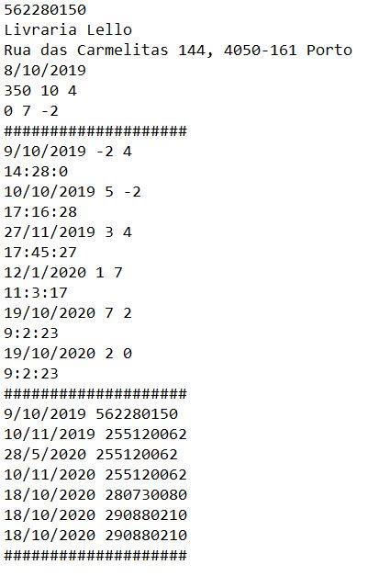
Files
PITCH
Lifts
clientNif
buildingName
install
capacity nFloors regularTime
currentFloor higherFloor lowerFloor
####################
movesHistory
####################
maintHistory
####################
date from to
date nifEmployee
AEDA Grupo 2 Turma 4

Slide 8
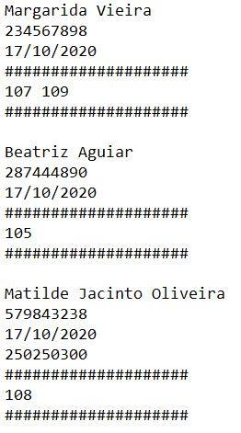
Files
PITCH
Clients
name
Nif
firstLift
employeeNif (if Entrepreneur)
####################
lifts (identificados pelo code)
####################
AEDA Grupo 2 Turma 4

Slide 9
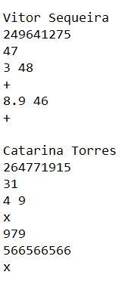
Files
PITCH
Employees
name
nif
age
evaluation numReviews
+ (+ symbol indicates Service Provider)
perHourSalary hoursWorked
+
ou
x (x symbol indicates Contracted Employee)
perMonthSalary
clientNif1 clientNif2….
x
If Entrepreneur has no clientes: 0
AEDA Grupo 2 Turma 4

Slide 10
Exceptions
PITCH
ClientDoesNotExist
EmployeeDoesNotExist
LiftDoesNotExist
This exception is used in all search…() functions and is thrown every time the searched object doesn’t exist.
string what; (e.g what = “Client does not exist)
Used when:
searching for Employee associated
associating employee to client
NotAnEntrepreneur
InvalidTime
Checks time validity (e.g 0 < hours < 24) everytime it receives times.
Checks date validity (e.g 1 < month < 12) everytime it receives dates.
InvalidDate
Used in lift constructor.
Number of floors must be bigger than 0.
InvalidNumFloors
AEDA Grupo 2 Turma 4

Slide 11
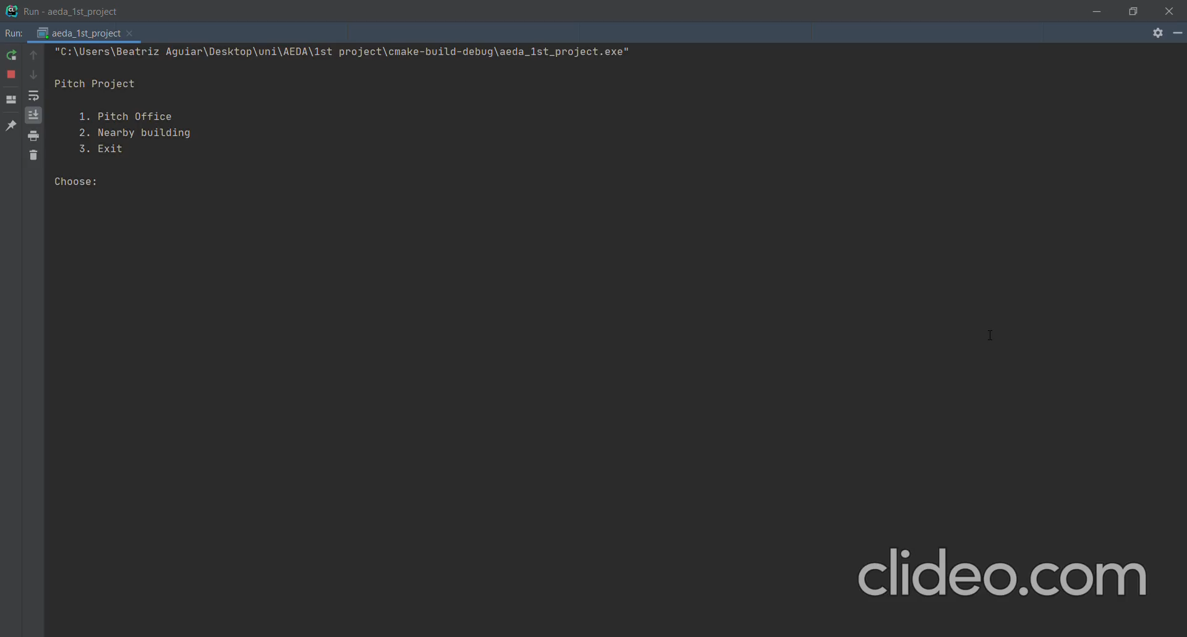
Interface
PITCH
Office’s demo
AEDA Grupo 2 Turma 4

Slide 12
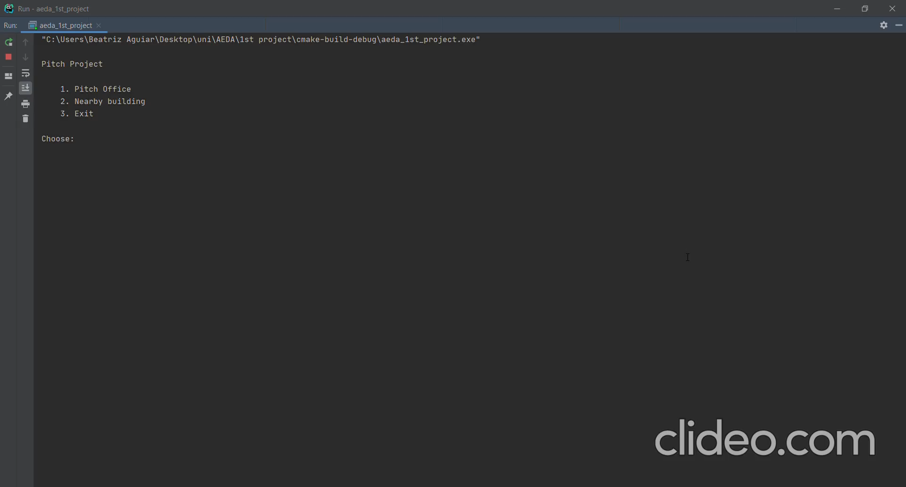
Interface
PITCH
2. Building’s demo
AEDA Grupo 2 Turma 4

Slide 13
Star of the show
PITCH
From the user point of view, clearly, the realistic effect created with the delays in between floor is one of the best features. We do recognize that for its creativity but not for its difficulty.
As the programmers, who were constantly challenged, it is the way we implemented the connections that really shows off. We tried our best to use a little of everything we have learned, such as template functions, algorithms of search and sort, inheritance, operators overload, etc.
We would also like to point out that we tried to think of a way to use either stacks or queues but didn’t see its utility nor efficiency in our programme.
AEDA Grupo 2 Turma 4

Slide 14
Overview
PITCH
Programming
conquests
Challenges
Evaluation
Git
Employees purpose
Files output
We consider to have worked very well as a group.
0.333(3)… to each.
Acquire agility with:
Classes and its connections
Pointers
Exceptions
Git
AEDA Grupo 2 Turma 4

